Slide 1
Disparities in Breast Cancer 2015
Edith Peterson Mitchell, MD, FACP
Clinical Professor of Medicine and Medical Oncology
Program Leader, Gastrointestinal Oncology
Department of Medical Oncology
Associate Director for Diversity Programs
Kimmel Cancer Center at Jefferson
Philadelphia, Pennsylvania
President, National Medical Association

Slide 2
No disclosures.

Slide 3
Overview
Epidemiology
Explanation for differential survival rates
  Patient & system factors impacting:
  Early detection
  Access to care & quality of care
Pathologic features – how does that impact outcome?
Understanding triple negative disease

Slide 4
Incidence of Cancer in Women
250
United States 1975-2000
200
150
Breast
Rate per 100,000
100
Colon & Rectum
Lung
50
Uterus
0
Ovary
1975
1976
1977
1978
1979
1980
1981
1982
1983
1984
1985
1986
1987
1988
1989
1990
1991
1992
1993
1994
1995
1996
1997
1998
1999
2000
Year
Adapted from American Cancer Society. Cancer Facts and Figures 2004.
Notes:
Breast cancer is the most common malignancy in women and the second leading cause of cancer death (exceeded by lung cancer)
The incidence of breast cancer has been increasing steadily from an incidence of 1:20 in 1960 to 1:7 women today

Slide 5
Prognostic Factors in Breast Cancer
Tumor size
Node involvement
Histologic grade
Estrogen/progesterone receptors
HER-2/neu status
Degree of differentiation
Donegan WL. CA Cancer J Clin. 1997;47:28-51.
Notes:
There is a direct correlation between number of involved nodes and survival
ER status is predictive for disease-free and overall survival
Irrespective of stage, ER positivity predicts for longer disease-free and overall survival. Higher recurrence and lower survival rates are found in ER-negative patients. About 60% of ER-positive patients will respond to hormonal manipulation.
Patients over-expressing HER-2/neu have a higher risk of recurrence and shorter survival

Slide 6
Annual Cancer Mortality
United States 1930-2000
50
Lung
40
Breast
30
Rate per 100,000
Colon & Rectum
20
10
Ovary
Uterus
0
1930
1940
1950
1960
1970
1980
1990
2000
Year
Adapted from American Cancer Society. Cancer Facts and Figures 2004.
Notes:
Although the incidence of breast cancer is increasing, the mortality rates from breast cancer have decreased approximately 1.9% per year since 1190 in the US¹
The nation's leading cancer organizations report that Americans’ risk of dying from cancer continues to decline and that the rate of new cancers is holding steady²
Cancer death rates from all cancers combined dropped 1.1 percent per year from 1993 to 2002. Declines in death rates reflect progress in prevention, early detection, and treatment.²
Esteva FJ, et al. Oncologist. 2001;6:133-146.
Goodson WH, et al. J Natl Cancer Inst. Oct 5, 2005.

Slide 7
Factors Contributing to Declining US Mortality
Increased awareness and screening
Early detection
Improvements in technology
New developments in pathological assessments
Improvements in treatment
American Cancer Society. Breast Cancer Facts and Figures 2005-2006; Berry D, et al. N Engl J Med. 2005;353:1784-1792.
Notes:
Screening can reduce the rate of death from breast cancer only when followed by treatment
Tumors that are detected by screening before they metastasize can be eradicated by surgery, and breast cancer detected at an early stage of metastasis can be effectively treated by chemotherapy

Slide 8

Racial Differences
in Cancer:
A Comparison of Black and White Adults in the United States
Robin Hertz, Ph.D
Edith Mitchell, MD, FACP
Notes:
This issue of Pfizer Facts presents new analyses of national databases to gain insight into the burden of cancer among black adults with comparison to the white adult population. The report addresses cancer morbidity and mortality, coexisting conditions experienced by cancer patients and survivors, cost of care, behavioral risk factors and prevention.

Slide 9
Breast Cancer Incidence Rates by Race and Age
Black
White
Rate per 100,000 female population
Age at diagnosis
Source: SEER 1996–2001
Note: Graphs may not begin at age 20 due to sample size limitations.
18
Notes:
Note: Breast cancer rates represent women only.
Breast cancer incidence varies by age and peaks between ages 75 to 79 for both blacks and whites.

Slide 10
Age-adjusted Breast Cancer Mortality Rate by Race
Black
White
Age-adjusted rate per 100,000 female population
Year
Source: CDC 1990–2002. Age-adjusted to the 2000 US standard population
19
Notes:
Note: Breast cancer rates represent women only.
From 1990 to 2002, breast cancer mortality declined for both black and white females.
The drop in breast cancer mortality was less for black females than white females, leading to a growing racial disparity:
34 deaths per 100,000 black females compared with 25 deaths per 100,000 white females in 2002, a rate 36% higher in 2002 compared with 14% higher in 1990.

Slide 11
Five-year Relative Survival in Women With Breast Cancer by Race and Age
100
Black
White
90
80
70
60
50
Percent
40
30
20
10
0
Age at diagnosis
Source: SEER 1992–2001
Note: Graphs may not begin at age 20 due to sample size limitations.
20
Notes:
Note: Breast cancer rates represent women only.
Note: Five-year relative survival is the likelihood or chance of cancer patients surviving at least five years after diagnosis, relative to the expected likelihood of cancer-free persons (matched on age, sex, race, and year of observation) surviving at least five years.
The five-year relative survival rate for breast cancer in black women ranges from 73% to 81% for all five-year age groups between 40 and 79.
Breast cancer five-year relative survival for black women is about 10 percentage points lower than the survival rates for white women in the same age groups.

Slide 12
Breast Cancer Summary
Although the incidence of breast cancer is lower among black women than white women, black females have higher mortality and lower five-year relative survival
Breast cancer in black women is less likely to be diagnosed in the local stage compared with white women
Five-year relative survival rates are approximately ten percentage points lower for black women than for white women in each age group
25

Slide 13
Annual Direct Medical Spending for Total Cancer Treatment by Race and Payment Source, Age 40–64
Black
White
Other public
$0.10B (3.0%)
Other
$0.01B (0.3%)
Other public
$0.42B (3.7%)
Other
$0.16B (1.4%)
Medicaid
$0.40B (3.5%)
Medicaid
$0.69B
(21.1%)
Medicare
$1.25B
(10.9%)
Self-pay
$0.96B
(8.4%)
Medicare
$0.38B
(11.5%)
Private
$2.03B
(62.3%)
Private
$8.30B
(72.2%)
Self-pay
$0.06B
(1.8%)
Total annual spending = $3.26B
Total annual spending = $11.50B
Source: MEPS 1998–2002 annual average
Direct medical spending adjusted to year 2002 dollars
Note: Percents and spending may not add to totals because of rounding
13
Notes:
Note: Excludes basal and squamous skin cancers and carcinomas in situ. This exclusion applies to all analyses.
Note: Direct spending is a function of per person spending associated with the specific cancer and the number of persons seeking treatment for that cancer. Spending for other non-epithelial cancers of the skin and for primary and secondary malignant neoplasms with unspecified sites is excluded from this section.
An estimated 527,000 black adults 40 years of age and older and an estimated 7.46 million white adults aged 40 and older are treated annually for cancer.
$3.26 billion (B) is spent annually on cancer treatment for black adults aged 40 to 64.
$11.50B is spent annually on cancer treatment for white adults aged 40 to 64.
Among middle-aged blacks and whites, private insurers pay for 62% and 72% of annual cancer-related healthcare expenses, respectively.
In this same age group, Medicaid incurs 21% of total expenses associated with cancer among blacks, and 4% of cancer expenses among whites.

Slide 14
Annual Direct Medical Spending for Total Cancer Treatment by Race and Payment Source, Age 65 and Older
Black
White
Other
$0.03B (2.3%)
Other
$0.37B (2.7%)
Other public
$0.12B
(10.9%)
Private
$0.18B
(16.5%)
Other public
$0.75B (5.6%)
Private
$2.46B
(18.1%)
Medicaid
$0.12B
(0.9%)
Medicaid
$0.16B
(14.9%)
Self-pay
$0.04B
(3.8%)
Self-pay
$0.65B
(4.8%)
Medicare
$0.57B
(51.6%)
Medicare
$9.21B
(68.0%)
Total annual spending = $1.10B
Total annual spending = $13.56B
Source: MEPS 1998–2002 annual average
Direct medical spending adjusted to year 2002 dollars
Note: Percents and spending may not add to totals because of rounding
14
Notes:
Note: Excludes basal and squamous skin cancers and carcinomas in situ. This exclusion applies to all analyses.
Note: Direct spending is a function of per person spending associated with the specific cancer and the number of persons seeking treatment for that cancer. Spending for other non-epithelial cancers of the skin and for primary and secondary malignant neoplasms with unspecified sites is excluded from this section.
An estimated 527,000 black adults 40 years of age and older and an estimated 7.46 million white adults aged 40 and older are treated annually for cancer.
Medicare is the largest payer of cancer-related expenses for older blacks and whites, incurring 52% and 68% of total expenditures, respectively.
Among older blacks, Medicaid and other public payers incur 15% and 11% of total cancer expenses, compared with 1% and 6% among older white adults.

Slide 15
Causes of Health Disparities
Poverty /
low economic
status
Social injustice
Culture
Possible influence on gene environment interaction
Early detection
Diagnosis/
incidence
Post treatment/
quality of life
Survival and mortality
Prevention
Treatment
Freeman H. Adapted from Cancer Epidemiology Biomarkers & Prevention, April 2003.

Slide 16
National Cancer Data Base
M.C. Lee et al, 2007 Breast Cancer Symposium
Data base maintained by ACS (American College of Surgeons)
70% of cases reported in US
>1,600 hospitals in all 51 states
170,079 cases – in situ and invasive diagnosed 1998

Slide 17
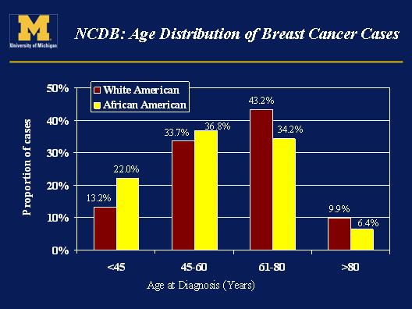

Slide 18
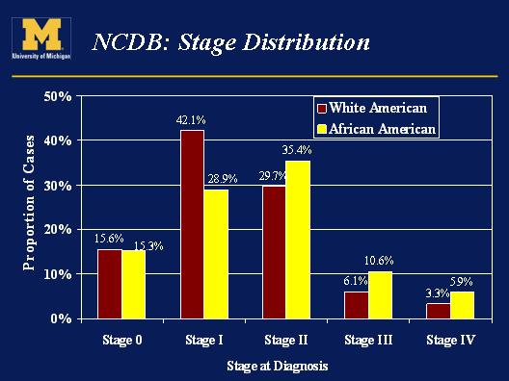

Slide 19
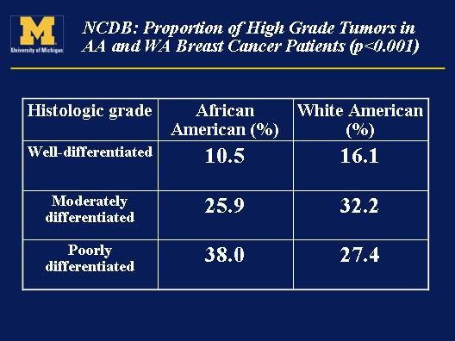

Slide 20
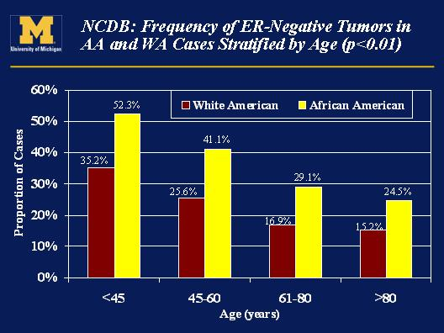

Slide 21
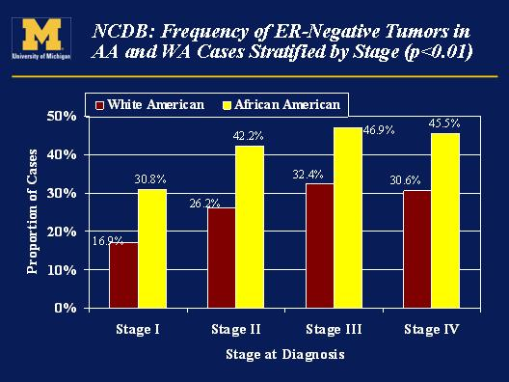

Slide 22
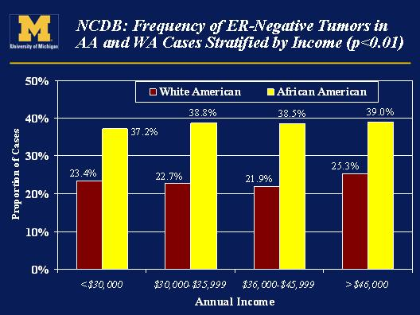

Slide 23
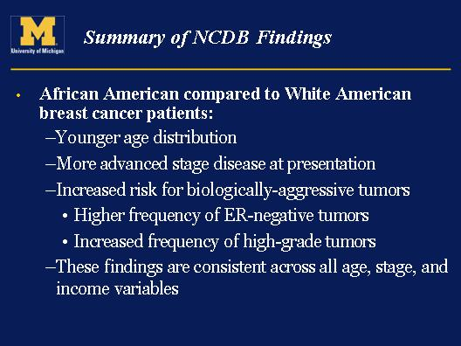

Slide 24
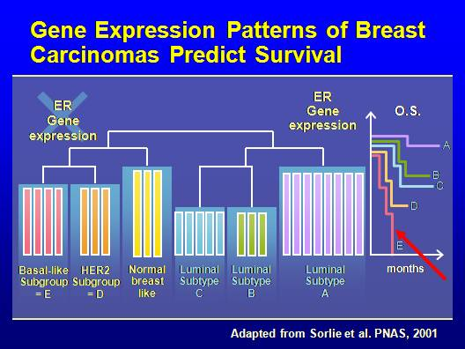

Slide 25
PARP is an Important Enzyme in DNA Repair of Normal Cells as Well as Cancer Cells
Environmental factors
(UV, radiation, chemicals)
DNA DAMAGE
  Normal physiology
  (DNA replication)
Cell Death
  Chemotherapy, Radiotherapy
DNA REPAIR PATHWAYS
Replication Lesions
Base excision repair
  PARP1
Single Strand Breaks
Base excision repair
  PARP1
Double Strand Breaks
Homologous recombination
  BRCA1/BRCA2
DNA Adducts/Base Damage
Base excision repair
  PARP1

Slide 26
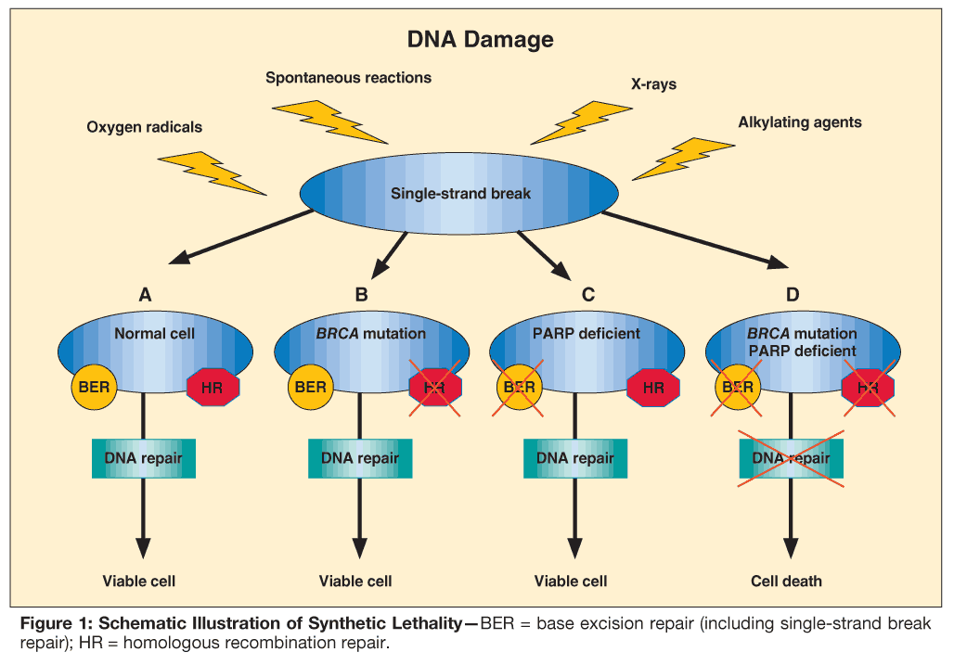
Parp Inhibitors-Mechanism of Action
http://clinicianonnet.blogspot.com/2010/06/recent-advances-on-breast-cancer.html

Slide 27
Differences in breast carcinoma characteristics in newly diagnosed African-American and Caucasian patients; a single-institution compilation compared with the National Cancer Institute SEER database (Morris et al).
Results: More AA pts presented with advanced stage (AS) tumors in both databases, and higher histologic grade (p<0.001) and nuclear grade than C pts (p<0.001).
AA pts had lower ER-positivity (51.9% vs. 63.1%, p<0.001) but significantly higher ki-67 (42.4% vs. 28.7%, p<0.001) and p53 expression (19.4% vs. 13.1%, p<0.05) than C pts with all stages of tumors.
Basal or “triple-negative” breast cancer phenotype was found to be more common in AA pts as compared with C pts (20.8% vs 10.4%, p<0.0001), associated with higher histologic and nuclear grade (p<0.0001).

Slide 28
Biomedical Informatics in Translational Research
Clinicians
Biomarkers, Risk Factors, Disease Models
Analytical Portal
Patient
Treatment
Data Warehouse
Firewall
Clinical Data Collection
Limited Data Set
Or Safe Harbor
Subject Enrollment
Subject ID
Specimen ID
Tissue Banking: Blood-products, Solid Tissues, etc.
Molecular Studies
Specimen Collection
Clinical Perspective
Research Perspective
Adapted from Hu H and Liebman MN, Ch 18 in Deng HW…, Hu H (eds). Current Topics in Human Genetics. 2007.

Slide 29

Consortium Approach
Therapy-relevant subclassification of breast cancer based on in situ quantitative immunofluorescence profiling
  5,000 primary breast cancer specimens
  250 therapy-relevant proteins
Edith Mitchell, Col Craig Shriver, Jeff Hooke, Hallgeir Rui, Al Kovatich, Hai Hu, John Eberhardt
Berger Jaslow Mitchell Rui, Hyslop Ertel Avery Palazzo
Surgery Med Onc Cancer Biology Biostatistics Informatics Pathology

Slide 30
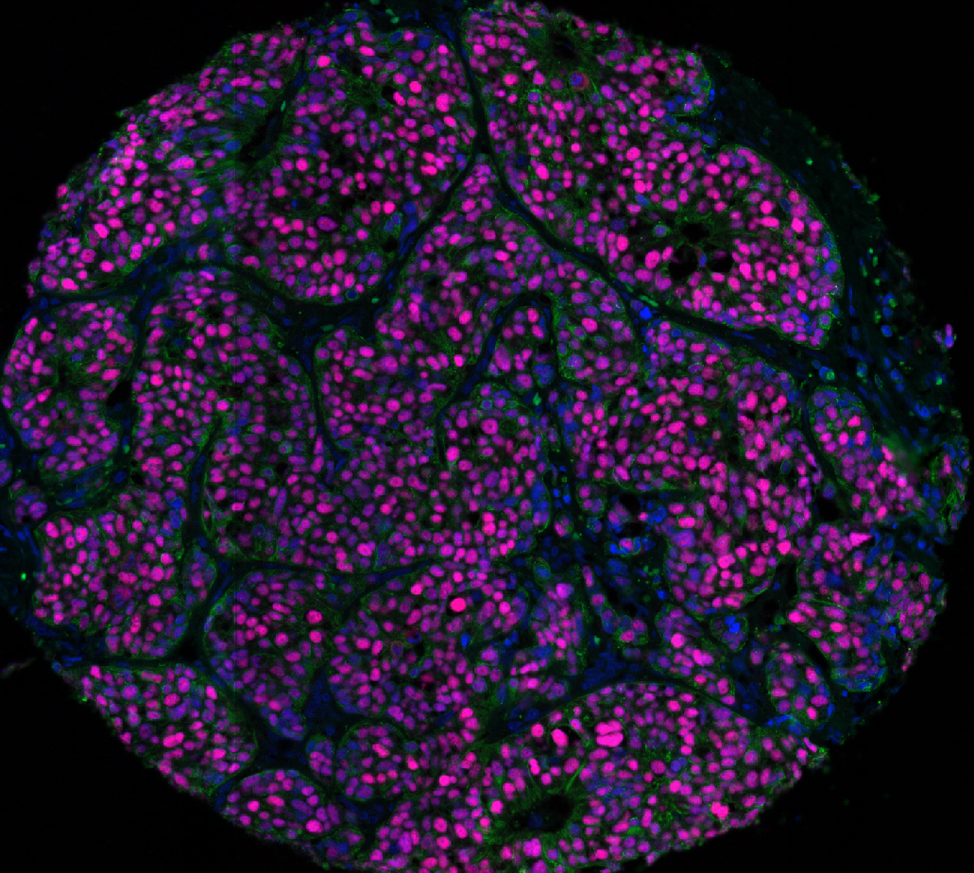
Phospho-Stat5 staining of breast cancer (red)
Rui-lab, Jefferson - Note dynamic range of signal

Slide 31
Veliparib-trial
Avery, Mitchell, Berger, Hyslop, Rui, others.
Komen-supported
RANDOMIZE
ON STUDY
Paclitaxel +
Carboplatin
SURGERY
AC
Screening
Paclitaxel +
Carboplatin + Veliparib
AC
12 weekly cycles
4 x 3-week cycles
Consent
Investig.
Biopsy A
CTC
Investig.
Biopsy B
CTC
Surgical Tissue
CTC
MRI
PET/CT or CT + Bone Scan
US/MG
Diagn. Biopsy: ER/PR/Her2 neg
Time (months)
0
1
2
3
4
5
6

Slide 32
Biomarkers
Standard markers – ER, PR, Her2 – will define triple-negative status.
Qualifying markers –CK5, EGFR, p53, Ki67, Parp1, ERCC1, phosphoHistoneH3, Thymidylate synthase, Cyclin D1, p16.
Exploratory markers –CK14, CK17, Cyclin B1, p63, CD44, CD24, Vimentin, Thymidine phosphorylase, gammaH2AX, Geminin, RAD51, ID4, p73, Dec1.
Markers to be performed on investigational core biopsies 1 and 2: CK5, EGFR, p53, ki67, Dec1, Parp1, ERCC1, phosphoHistoneH3, TS, Cyclin D1, p16.

Slide 33
Integrating Minority Populations and Gender into SKCC Research and Clinical Trials
_{Populations}
Behavioral and Epidemiology Science
_{Community Outreach}
_{and Education}
_{Increased}
_{Accrual}
_{Clinical Science}
_{Partnerships/Strategies}
_{to Overcome Barriers}
_{Basic Science}

Slide 34

Questions?
Edith.Mitchell@jefferson.edu

