Slide 1
Metastatic Breast Cancer: A Medical Update
Jennifer M. Matro, MD
Rena Rowan Breast Center
Abramson Cancer Center
University of Pennsylvania

Slide 2
Overview
What is metastatic breast cancer (MBC)?
Who is at risk?
Subtypes of Breast Cancer
Treatment of MBC
Local v. systemic
Standard of care v. clinical trial
How should I decide on a treatment plan?
What are the current standards and what’s new on the research front?
Where are we headed with future research?
Notes:
Who? (stats on those being diagnosed at this time)
What is MBC? (understanding MBC)
Subtypes of breast cancer: In order to talk about treatment of MBC, need to know about the different subtypes
Treatment type? Local v. Systemic, standard v. clinical trial
Where are we heading with future research and treatment interventions?

Slide 3
What is metastatic breast cancer (MBC)?

Slide 4
What is “metastatic breast cancer”?
“Metastatic” = “Advanced” = “Stage 4”
Cells from the original breast cancer have spread outside of the breast and surrounding lymph nodes
New tumors (or “lesions”, “nodules”, “masses”) are evident
Common sites: bones, organs (liver, lungs), brain, lymph nodes, skin

Slide 5
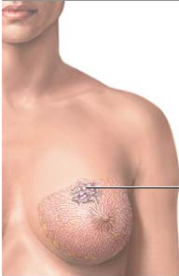
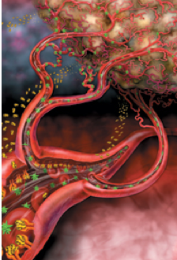
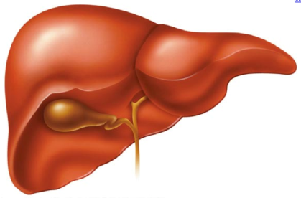
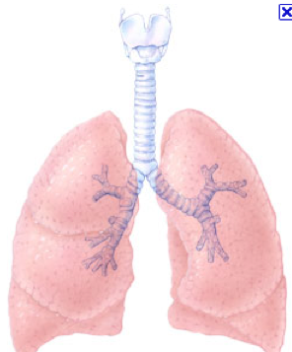
How does cancer become “metastatic”
Circulating tumor cell “seeds” can travel to new sites and form tumors

Slide 6
Metastatic breast cancer facts
Most breast cancer patients will never get this
It is highly treatable
People can live with this for many years, with very good quality of life

Slide 7
Who is at risk for mbc?

Slide 8
Breast Cancer: Who?
Breast cancer is the most commonly diagnosed cancer in women and the 2nd most common cause of cancer death
In 2015, 231,840 new breast cancer cases among women
The incidence of new breast cancer cases has declined due to decreased use of post-menopausal hormone therapy

Slide 9
Breast Cancer: Who?
~ 30% of newly diagnosed breast cancer patients will have tumor spread to regional lymph nodes
~ 5% will have metastases at presentation (“de novo”)
Up to 20% of women will develop MBC

Slide 10
MBC: Who?
Higher stage at diagnosis
# of lymph nodes
Tumor size
Triple negative > HER2 positive > Hormone receptor positive

Slide 11
3 main “types” of breast cancer
Hormone-receptor positive (ER+ and/or PR+): 65%
PR
ER
Her2-positive: 20-25%
“Triple-negative” (lacks all three receptors): 10-15%

Slide 12
MBC by Subtype
TNBC: Younger age, shortest time to metastatic disease (<3years); lung/brain > bone/liver
HER2+: Younger age, shorter time to metastatic disease (<5yr); liver mets more common than HR+; brain common
ER/PR+: Older, lowest risk of metastasis, long disease free interval (can develop >10-20yrs after diagnosis); bone most common

Slide 13
Metastatic breast cancer challenges
Each cancer and patient is unique
Every cancer has multiple mutations or gene copy number alterations
Cancers are heterogeneous
Metastases can be different in different parts of the body
Drug resistance
Cancers can adapt to tolerate therapies

Slide 14
Treatment of Metastatic Breast Cancer
Local v. Systemic
Standard of care v. Clinical trial

Slide 15
Local treatment options
Reserved for areas that need intensive local control for
Pain, Obstruction, Poor healing, Brain/spinal cord issues
Types:
Radiation
Stereotactic vs. traditional
Surgery
Pros: Intensive, quick local effect
Cons: Need to pause treatment to other areas, doesn’t address the need to control spread through the bloodstream

Slide 16
Systemic treatment based on “types” and “targets”
Hormone-receptor positive (ER+ and/or PR+)
Anti-estrogens
“Targets” of resistance
Chemotherapy
P
E
Her2-positive
Anti-Her2 targeted therapy
Chemotherapy
Triple-negative:
Chemotherapy
Looking for new “targets”

Slide 17
What is “targeted therapy”?
Treatments are linked to the biology of the cancer
We identify unique “targets” for the drugs to attack
Treatments have fewer general side effects
Less damage to normal cells (i.e. hair follicles)
Many drugs are oral

Slide 18
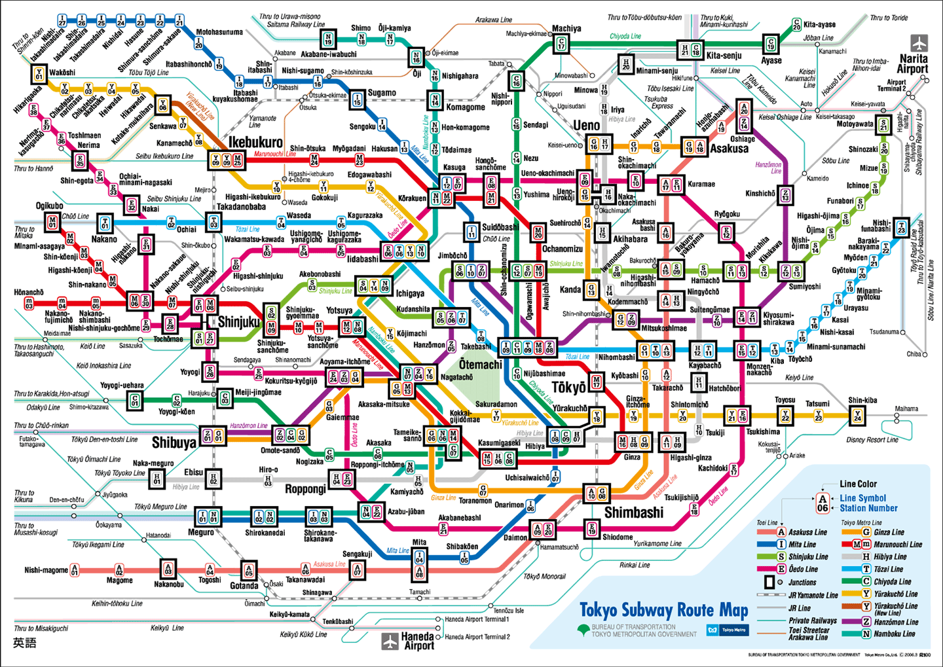
Cancer cells have “targets” inside and out

Slide 19
standard of care v. clinical trials?
Overview of clinical trials, drug selection and development
Notes:
Brief overview of where we are in the treatment of MBC in terms of standard of care and approved therapies. When should you consider clinical trials, and what kind of clinical trial?
Before I discuss the “when” let me first give an overview of clinical trials and drug development broadly, and in cancer drug development specifically
I’ll also discuss some recent advances and “newish” drugs now being incorporated into older/standard therapies

Slide 20
Drug development in oncology
Drugs are tested in clinical trials
Distinct phases: I, II, III
Limited to certain stages of disease
Metastatic
Neoadjuvant or adjuvant
Focus on the biology of the tumor
Newest drugs are “targeted to the tumor”

Slide 21
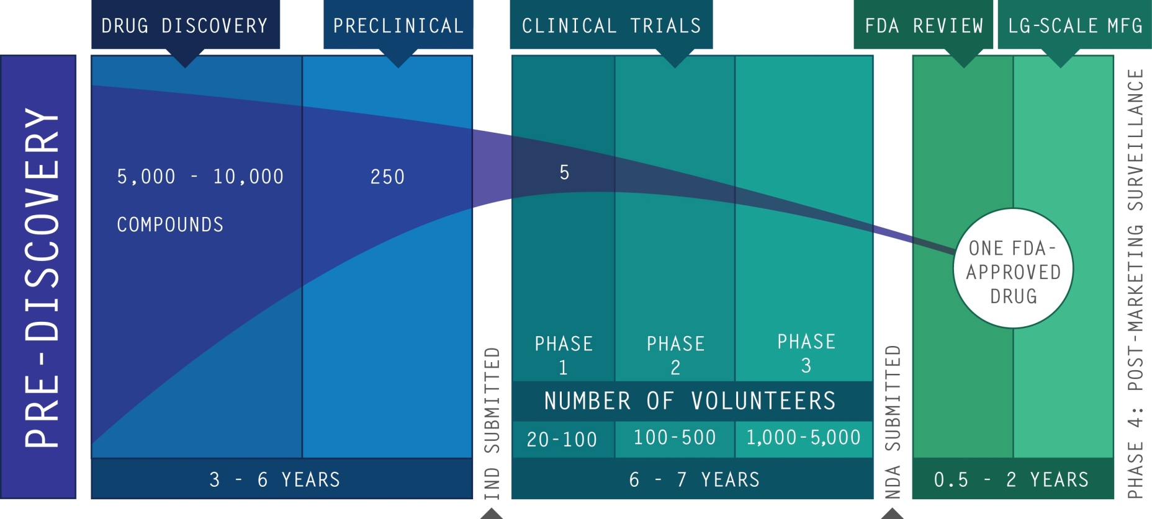
The drug development “pipeline”
One FDA-Approved Drug - Start to Finish
10- 15 Years
1,000 – 6,000 Volunteers
$1 Billion
Courtesy L. Esserman

Slide 22
Novel breast cancer targets
IGFR
Cell Surface Receptors
Her2
EGFR
FasL
HER-2
Angiopoietin-1
TRAIL
VEGF
Tumor Cell
Endothelial Cell
TIE
P
PI3K
P
PI3K
P
PI3K
PIP₂
PIP₃
P
PI3K
P
PI3K
PTEN
P
PI3K
Activated
AKT
RAS/RAF
Caspase-2
Block circuits
Protein damage
p53
Bak
MDM2
mTOR
MEK
HSP90
DNA Damage
Bax
tBid
mito
Bcl-xL
p53
MET
Bcl-2
Growth, Translation
DNA Repair
Cell Cycle Arrest
Apoptosis
(Cell turnover)
Metabolism
Angiogenesis (Blood supply)

Slide 23
deciding on a treatment plan
What are the current standards and what’s new on the research front?

Slide 24
Treatment strategy: ER+ or PR+
PR
ER
Anti-Estrogen
Anti-Estrogen + Resistance Target
Chemotherapy
Approved:
mTor: Everolimus (Afinitor)
CDK 4/6: Palbociclib (Ibrance)
Investigational:
JAK/STAT: Ruxolitinib
PI3 Kinase inhibitors
HDAC inhibitors
Tamoxifen
Fulvestrant (Faslodex)
Anastrozole (Arimidex)
Letrozole (Femara)
Exemestane (Aromasin)
Notes:
Most women have had tamoxifen or an aromatase inhibitor already
New strategies target pathways that circumvent hormone resistance
Often add targeted agent to hormone therapy

Slide 25
Afinitor (Everolimus)
Added to Exemestane (Aromasin)
Adds about 6 months of response time
2 separate studies
Side effects:
Mouth sores, anemia, shortness of breath, high blood glucose, fatigue, increased liver enzymes

Slide 26
Palbociclib (Ibrance)
Approved with Letrozole (Femara) in postmenopausal women, first line
Adds 10 months of response time
Side effects: mild lowering of white blood cell count, mild fatigue. ~20% rate of hair thinning

Slide 27
Palbociclib – New indication coming?
PALOMA3 – presented at ASCO 2015
Fulvestrant v. Fulvestrant + Palbo
Post AND PRE menopausal women eligible
Pts had progressed on prior endocrine rx (i.e., not 1st line)
Adding palbo extended treatment response by 5.4 months (9.2 v. 3.8mo)
Side effects: Lowering of white blood cells, fatigue

Slide 28
Treatment strategy: Her2+
Anti-Her2 antibody + / - Chemotherapy
Anti-Her2 small molecule + / - chemotherapy
Anti-Her2 antibody-drug conjugates
Antibodies:
Trastuzumab (Herceptin)
Pertuzumab (Perjeta)
Antibody-drug conjugate:
T-DM1 (Kadcyla)
Small Molecule:
Lapatinib

Slide 29
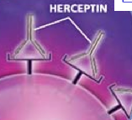
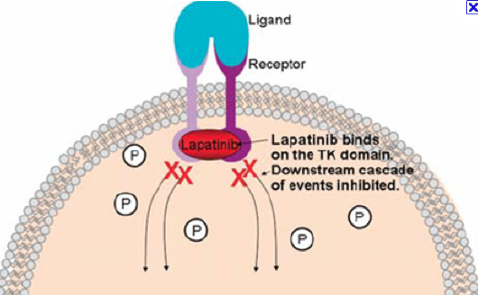
Approved targeted therapy for Her2+ breast cancer
Herceptin: An antibody that binds the receptor on the outside of the cell
Works best with chemotherapy
Can cause heart damage
Lapatinib: a small molecule that blocks Her2 on the inside of the cell
Also best with chemotherapy
Can cause diarrhea and rash

Slide 30
Pertuzumab (Perjeta)
Binds to different spot on the Her2 receptor than Herceptin
Can give both together
Docetaxel + Herceptin + Pertuzumab (CLEOPATRA)
“Unprecedented” benefit – 16 months
Side effects: small impact on blood counts, mild diarrhea
Considered standard first line regimen

Slide 31
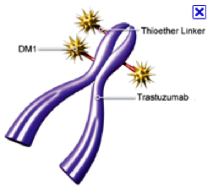
T-DM1 (Kadcyla)
Herceptin with a chemo drug bound to it
“Links” chemo to the Her2+ cell
More effective than standard chemo + Lapatinib
Adds >3 months response time
Less toxic
Given every 3 weeks
Low blood counts, increased liver tests
Very low rate of hair loss (<5%)

Slide 32
Treatment strategy: “Triple negative”
Lacks ER, PR and Her2 receptors
We don’t know the targets yet, so chemo is main treatment
Lots of important research to find these
Some that have been identified:
PARP inhibitors
Immune-related
Androgen receptor

Slide 33
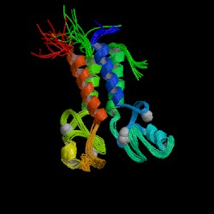
BRCA1 and BRCA2
Mutations are associated with increased risk of early onset breast and ovarian cancer
80% of BRCA-1 mutation associated cancers have triple negative features
Lack ability to repair damaged DNA
BRCA1 Protein Structure
Image courtesy of Protein Data Bank; http://www.rcsb.org/pdb

Slide 34
PARP inhibitors in “triple negative” breast cancer: current status
No evidence yet that these drugs work in non-BRCA mutated patients
Several agents are being studied
The neoadjuvant setting is being used to understand which tumors might respond
New technologies may make it possible to find tumors where the BRCA and other pathways are “turned off” without mutation

Slide 35
Why join a clinical trial?
Often the only way to get access to promising new drugs
Conducted in a very safe, monitored way
Won’t limit your options for standard treatments later
You will be helping us find a cure for breast cancer

Slide 36
When is a clinical trial appropriate?
No standard options left (in MBC, this is uncommon)
When you can get a standard option “plus”
Placebo v. experimental drug + a standard therapy
Early access to promising new drugs

Slide 37
Where are we heading with future research and treatment interventions?

Slide 38
New targeted therapies for MBC
ER/PR+
Approved: Everolimus, palbociclib
In trials:
PI3 kinase, HDACi
Cell cycle (CDK4/6)
JAK/STAT
Her2+
Approved: Herceptin, Lapatinib, Pertuzumab, T-DM1
In trials: Neratinib
Triple negative:
In trials: PARP inhibitors, glutaminase inhibitors, immunotherapy
Non-subtype specific:
In trials:
Angiogenesis
Notch
IGFR

Slide 39
Palbociclib (Ibrance)
Multiple ongoing trials to confirm/extend application
Paloma3 (add to fulvestrant; pre- & post-menopausal) – MBC
PEARL (add to exemestane, compare to capecitabine) - MBC
Adjuvant and post-neoadjuvant trials also underway

Slide 40
Ribociclib (LEE011, Novartis)
Currently in early phase single-agent trials and in combination with exemestane + everolimus
UPCC 06115: “LEE-PAC” - LEE011 + paclitaxel
Opening to patients this fall

Slide 41
Entinostat
HDAC inhibitor
Given breakthrough drug status by FDA based on phase 2 data of survival advantage
Phase 3 trial in combination with exemestane currently open (ECOG E2112) – males also eligible

Slide 42
JAK/STAT Pathway Inhibitors
UPCC 02112 (JAKEE): Exemestane + Ruxolitinib
ER/PR+, endocrine rx resistant
UPCC 12114: Capecitabine +/- Ruxolitinib
1:1 randomized to placebo
TNBC or ER/PR positive, HER2 negative
Up to 2 prior chemo regimens, any number of prior endocrine therapy allowed
Must have elevated C Reactive Protein (CRP)
Now open for patients

Slide 43
Immunotherapy
Not currently approved for breast cancer – but being studied
UPCC 40914 “RadVax”
Pembrolizumab (Keytruda) – a PD-1 inhibitor + Radiation
UPCC 45914 – phase I
Nivolumab + Abraxane (nab-paclitaxel)
Her2 negative; 2nd line
Both currently open

Slide 44
How to find a clinical trial that is right for you
Talk to your doctor
Contact our clinical trials center
1-855-216-0098
Look on the web
www.oncolink.com lists the trials at Penn
www.cancer.gov/clinicaltrials has all the trials in the country
https://www.breastcancertrials.org has a great breast cancer trial matching service

Slide 45
Thank you!
Questions?

